Slide 1
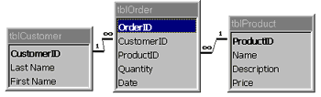
Mapping the Entity Diagram to a Relational Database
"What we don't understand, we cannot possess."
Slide # 4
Prof Yousef B. Mahdy

Slide 2

Topics
The Good and the Bad
Bad database design
  redundancy of fact
  fact clutter
  information loss
  dependency loss
Good database design
Normal Forms - overview
1NF, 2NF, 3NF, BCNF

Slide 3
Introduction
Suppose we are now given the task of designing and creating a database. How do we produce a good design? What relations should we have in the database? What attributes should these relations have? Good database design needless to say, is important. Careless design can lead to uncontrolled data redundancies that will lead to problems with data anomalies
Some data structures are better than others. Better ones avoid the modification anomalies which occur when an entity contains data about more than just one single thing.

Slide 4
Introduction
In this chapter we will examine a process known as Normalisation—a rigorous design tool that is based on the mathematical theory of relations which will result in very practical operational implementations. A properly normalised set of relations actually simplifies the retrieval and maintenance processes and the effort spent in ensuring good structures is certainly a worthwhile investment. Furthermore, if database relations were simply seen as file structures of some vague file system, then the power and flexibility of RDBMS cannot be exploited to the full.

Slide 5
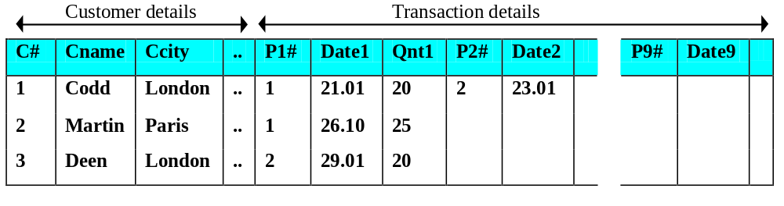
Bad Database Design
E.Codd has identified certain structural features in a relation which create retrieval and update problems. Suppose we start off with a relation with a structure and details like:
This is a simple and straightforward design. It consists of one relation where we have a single tuple for every customer and under that customer we keep all his transaction records about parts, up to a possible maximum of 9 transactions. For every new transaction, we need not repeat the customer details (of name, city and telephone), we simply add on a transaction detail.

Slide 6
disadvantages:
The relation is wide and clumsy
We have set a limit of 9 (or whatever reasonable value) transactions per customer. What if a customer has more than 9 transactions?
For customers with less than 9 transactions, it appears that we have to store null values in the remaining spaces. What a waste of space!
The transactions appear to be kept in ascending order of P#s. What if we have to delete, for customer Codd, the part numbered 1—should we move the part numbered 2 up (or rather, left)? If we did, what if we decide later to re-insert part 2? The additions and deletions can cause awkward data shuffling.
Let us try to construct a query to “Find which customer(s) bought P# 2” ? The query would have to access every customer tuple and for each tuple, examine every of its transaction looking for
(P1# = 2) OR (P2# = 2) OR (P3# = 2) … OR (P9# = 2)
A comparatively simple query seems to require a clumsy retrieval formulation!

Slide 7
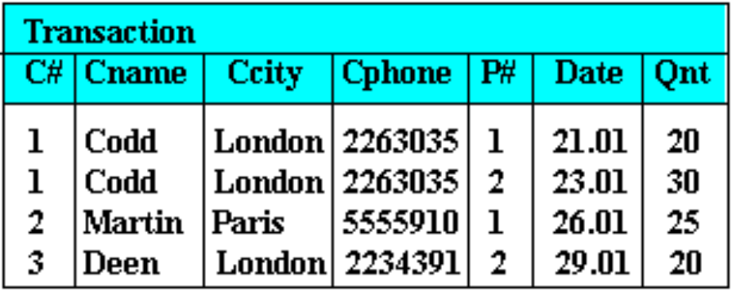
Another Bad Design
Alternatively, why don’t we re-structure our relation such that we do not restrict the number of transactions per customer. We can do this with the following structure:
This way, a customer can have just any number of Part transactions without worrying about any upper limit or wasted space through null values (as it was with the previous structure). Constructing a query to “Find which customer(s) bought P# 2” is not as cumbersome as before as one can now simply state: P# = 2.

Slide 8
But again, this structure is not without its faults:
It seems a waste of storage to keep repeated values of Cname, Ccity and Cphone.
If C# 1 were to change his telephone number, we would have to ensure that we update ALL occurrences of C# 1’s Cphone values. This means updating tuple 1, tuple 2 and all other tuples where there is an occurrence of C# 1. Otherwise, our database would be left in an inconsistent state.
Suppose we now have a new customer with C# 4. However, there is no part transaction yet with the customer as he has not ordered anything yet. We may find that we cannot insert this new information because we do not have a P# which serves as part of the ‘primary key’ of a tuple. (A primary key cannot have null values).
Suppose the third transaction has been canceled, i.e. we no longer need information about 20 of P# 1 being ordered on 26 Jan. We thus delete the third tuple. We are then left with the following relation:

Slide 9
Bad Database Design
As illustrated in the above instances, we note that badly designed, unnormalised relations waste storage space. Worse, they give rise to the following storage irregularities:
Update anomaly
  Data inconsistency or loss of data integrity can arise from data redundancy/repetition and partial update.
Insertion anomaly
  Data cannot be added because some other data is absent.
Deletion anomaly
  Data maybe unintentionally lost through the deletion of other data.

Slide 10
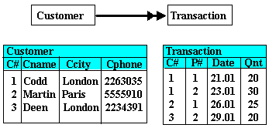
The Need for Normalisation
Intuitively, it would seem that these undesirable features can be removed by breaking a relation into other relations with desirable structures. We shall attempt by splitting the above Transaction relation into the following two relations, Customer and Transaction, which can be viewed as entities with a one to many relationship.

Slide 11
Let us see if this new design will alleviate the above storage anomalies:
Update anomaly
  If C# 1 were to change his telephone number, as there is only one occurrence of the tuple in the Customer relation, we need to update only that one tuple as there are no redundant/duplicate tuples.
Addition anomaly
  Adding a new customer with C# 4 can be easily done in the Customer relation of which C# serves as the primary key. With no P# yet, a tuple in Transaction need not be created.
Deletion anomaly
  Canceling the third transaction about 20 of P# 1 being ordered on 26 Jan would now mean deleting only the third tuple of the new Transaction relation above. This leaves information about Martin still intact in the new Customer relation.

Slide 12
Normalisation
This process of reducing a relation into simpler structures is the process of Normalisation. Normalisation may be defined as a step by step reversible process of transforming an unnormalised relation into relations with progressively simpler structures. Since the process is reversible, no information is lost in the transformation.
Primarily a tool to validate and improve a logical design so that it satisfies certain constraints that avoid unnecessary duplication of data
The process of decomposing relations with anomalies to produce smaller, well-structured relations
Normalisation removes (or more accurately, minimises) the undesirable properties by working through a series of stages called Normal Forms. Originally, Codd defined three types of undesirable properties:
  Data aggregates
  Partial key dependency
  Indirect key dependency
and the three stages of normalisation that remove the associated problems are known, respectively, as the:
  First Normal Form (1NF)
  Second Normal Form (2NF), and
  Third Normal Form (3NF)

Slide 13
Overview of NFs
NF²
1NF
2NF
3NF
BCNF

Slide 14
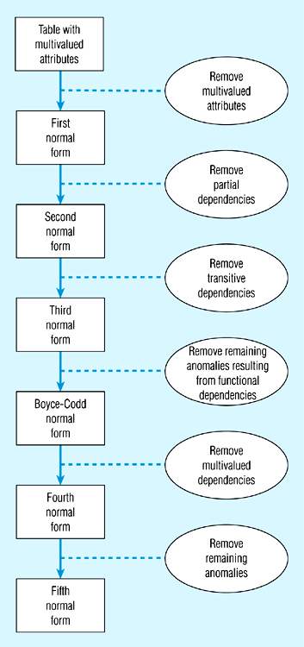
Steps in ormalization

Slide 15
Well-Structured Relations
A relation that contains minimal data redundancy and allows users to insert, delete, and update rows without causing data inconsistencies
Goal is to avoid anomalies
  Insertion Anomaly – adding new rows forces user to create duplicate data
  Deletion Anomaly – deleting rows may cause a loss of data that would be needed for other future rows
  Modification Anomaly – changing data in a row forces changes to other rows because of duplication
General rule of thumb: a table should not pertain to more than one entity type

Slide 16
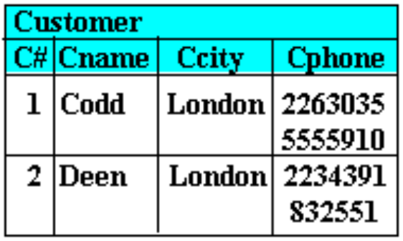
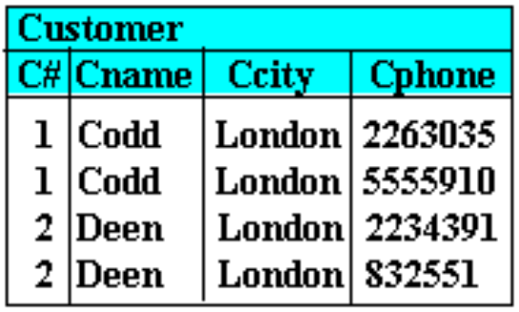
First Normal Form (1NF)
The purpose of the First Normal Form (1NF) is to simplify the structure of a relation by ensuring that it does not contain data aggregates or repeating groups. By this we mean that no attribute value can have a set of values. In the example below, any one customer has a group of several telephone entries:
This is thus not in 1NF. It must be “flattened”. This can be achieved by ensuring that every tuple defines a single entity by containing only atomic values. One can either re-organise into one relation as in:
No multivalued attributes
Every attribute value is atomic

Slide 17
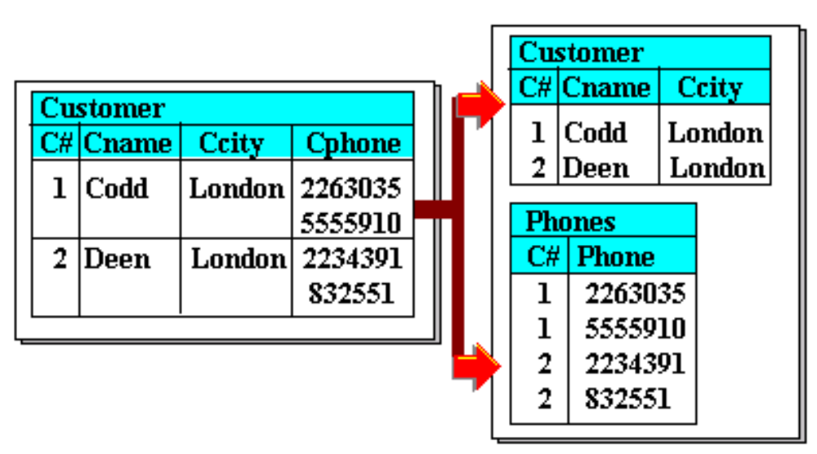
First Normal Form (1NF)
or split into multiple relations as in:
We may thus generalise by saying that “A relation is in the 1NF if the values in the relation are atomic for every single attribute of the relation”.

Slide 18
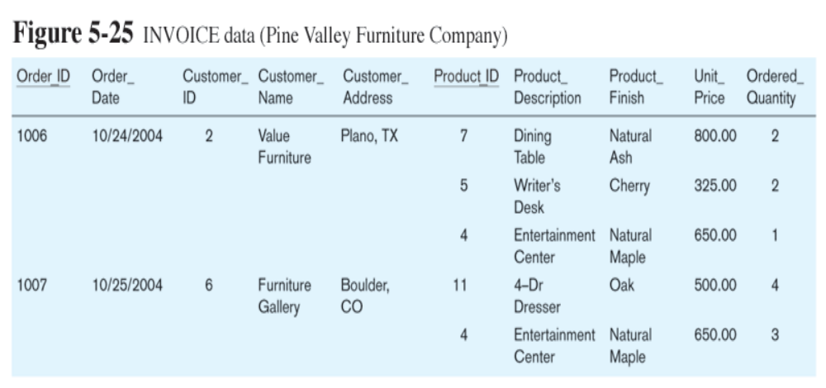
Table with multivalued attributes, not in 1st normal form

Slide 19

Functional Dependencies
The value of an attribute can uniquely determine the value in another attribute. For example, in every tuple of the Transaction relation:
  C# uniquely determines Cname
  C# also uniquely determines Ccity as well as Cphone
Given C# 1, we will know that its Cname is ‘Codd’ and no other. On the other hand, we cannot say that given Ccity ‘London’, we will know that its Cname is ‘Codd’ because Ccity ‘London’ will also give Cname of ‘Deen’. Thus Ccity cannot uniquely determine Cname (in the same way that C# can).

Slide 20
Additionally, we see that:
  (C#, P#, Date) uniquely determines Qnt
We can now introduce the definition of a “determinant” as being an attribute (or a set of non-redundant) attributes which can act as a unique identifier of another attribute (or another set of attributes) of a given relation.
We may thus say that:
  C# is a unique key for Cname, Ccity and Cphone.
  (C#, P#, Date) is a unique key for Qnt.
These keys are non-redundant keys as no member of the composite attribute can be left out of the set. Hence, C# is a determinant of Cname, Ccity, and Cphone. (C#, P#, Date) is a determinant of Qnt.

Slide 21
Functional Dependencies -Determinant
A determinant is written as:
  A → B
and can be read as “A determines B” (or A is a determinant of B). If any two tuples in the relation R have the same value for the A attribute, then they must also have the same value for their B attribute.
Applying this to the Transaction relation above, we may then say:
  C# → Cname
  C# → Ccity
  C# → Cphone
  (C#, P#, Date) → Qnt
The value of the attribute on the left-hand side of the arrow is the determinant because its value uniquely determines the value of the attribute on the right.
Note also that:
  (Ccity, Cphone) → Cname
  (Ccity, Cphone) → C#

Slide 22
Functional Dependencies -Determinant
The converse notation
  A X B
can be read as A “does not determine” B.
Taking again the Transaction relation, we may say therefore that Ccity cannot uniquely determine Cname
  Ccity X Cname
because there exists a number of customers living in the same city.
Likewise:
  Cname X (Ccity, Cphone)
  Cname X C#
as there may exist customers with the same name

Slide 23
Functional Dependence
The role of determinants is also expressed as “functional dependencies” whereby we can say:
  “If an attribute A is a determinant of an attribute B, then B is said to be functionally dependent on A”.
and likewise
  “Given a relation R, attribute B of R is functionally dependent on attribute A if and only if each A-value in R has associated with it one B-value in R at any one time”

Slide 24
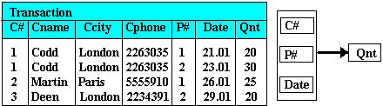
Functional Dependence
“C# is a determinant of Cname, Ccity and Cphone” is thus also “Cname, Ccity and Cphone are functionally dependent on C#. Given a particular value of Cname value, there exists precisely one corresponding value for each of Cname, Ccity and Cphone. This is more clearly seen via the following functional dependency diagram:

Slide 25
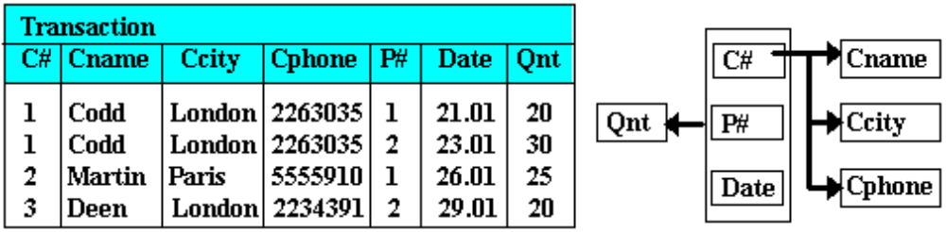
Full Functional Dependence
“If an attribute (or a set of attributes) A is a determinant of an attribute (or a set of attributes) B, then B is said to be fully functionally dependent on A”
and likewise
  “Given a relation R, attribute B of R is fully functionally dependent on attribute A of R if it is functionally dependent on A and not functionally dependent on any subset of A (A must be composite)”.

Slide 26
For the Transaction relation, we may now say that:
  Cname is fully functionally dependent on C#
  Ccity is fully functionally dependent on C#
  Cphone is fully functionally dependent on C#
  Qnt is fully functionally dependent on (C#, P#, Date)
  Cname is not fully functionally dependent on (C#, P#, Date), it is only partially dependent on it (and similarly for Ccity and Cphone).
  Having understood about determinants and functional dependencies, we are now in a position to explain the rules of the second and third normal forms.

Slide 27
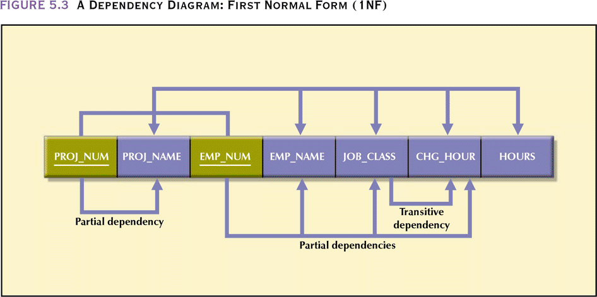

Slide 28
ILLUSTRATIVE EXAMPLE
Consider the scheme:
(STUID, STUNAME, MAJOR, CREDITS, STATUS, SOCSEC)
Let us use also the following instance:
STUID STUNAME MAJOR CREDITS STATUS SOCSEC
12541 Smith, Ted CS 99 SR 112345432
61423 Lan, Jackie EE 15 FR 342436786
96251 Shore, Sam PHYS 65 JR 234758987
***********************************************************************
We have the following FD's:
STUID ------> STUNAME
STUID ------> STUNAME, MAJOR, CREDITS, STATUS, SOCSEC
SOCSEC------> STUID, STUNAME, MAJOR, CREDITS, STATUS
CREDITS-----> STATUS`

Slide 29
BE CAREFUL WITH FUNCTIONAL DEPENDENCIES!
Concentrate on the meaning of attributes, and their constraints, in identifying FD's
  Be EXTRA careful in making judgments from instances only.
  The following FD's are FALSE:
    STUNAME -----> STUID
    STATUS -----> CREDITS
A superkey is an attribute or a set of attributes that identify an entity UNIQUELY.
  In a relation (table), a SUPERKEY is any column or set of columns whose values can be used to distingish one row from another.
Since a superkey identifies each item uniquely, it functionally determines all the attributes of a relation.
  STUID is a superkey
  SOCSEC is a superkey
  STUNAME is NOT a superkey
  STUID,STUNAME IS a superkey
  STUID,ANY OTHER SET OF ATTRIBUTES is a superkey

Slide 30
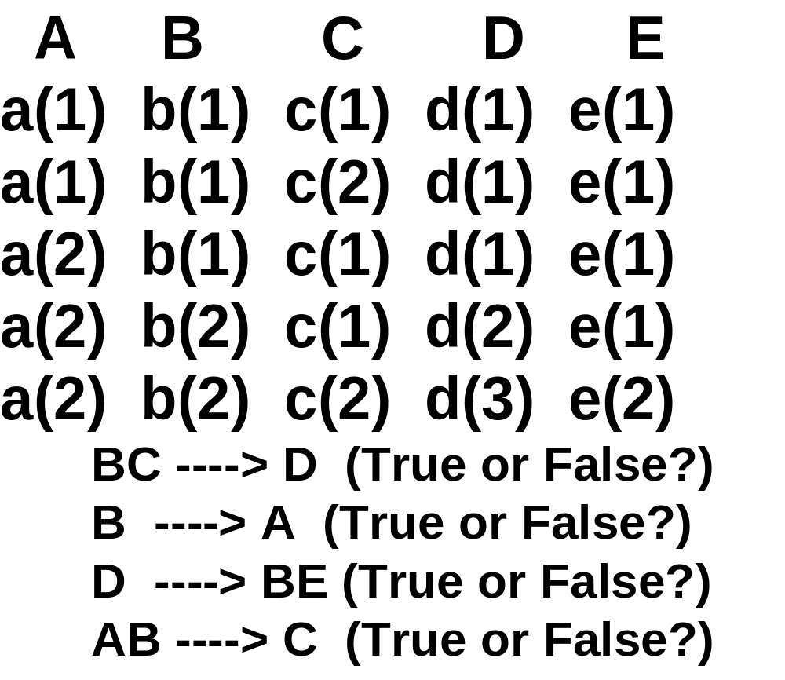
Example:

Slide 31
DEDUCING FUNCTIONAL DEPENDENCIES
Since BC ----> D and D ----> BE, can we say BC ----> BE ?

Slide 32
DEDUCING FUNCTIONAL DEPENDENCIES
Since BC ----> D and D ----> BE, can we say BC ----> BE ?
YES! (We will call this transitivity)

Slide 33
DEDUCING FUNCTIONAL DEPENDENCIES
Since BC ----> D and D ----> BE, can we say BC ----> BE ?
YES! (We will call this transitivity)
If BC ----> D and BC ----> A, can we say D ----> A ?

Slide 34
DEDUCING FUNCTIONAL DEPENDENCIES
Since BC ----> D and D ----> BE, can we say BC ----> BE ?
YES! (We will call this transitivity)
If BC ----> D and BC ----> A, can we say D ----> A ?
NO! Nor can we conclude A ----> D.

Slide 35
Second Normal Form
1NF PLUS every non-key attribute is fully functionally dependent on the ENTIRE primary key
  Every non-key attribute must be defined by the entire key, not by only part of the key
  No partial functional dependencies

Slide 36
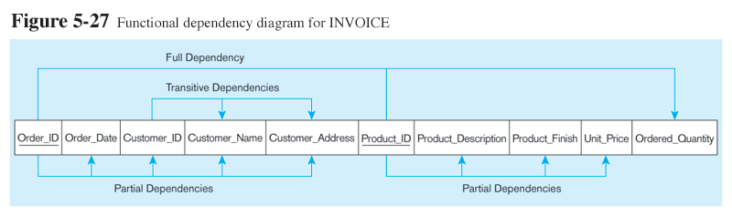
Order_ID ➔ Order_Date, Customer_ID, Customer_Name, Customer_Address
Customer_ID ➔ Customer_Name, Customer_Address
Product_ID ➔ Product_Description, Product_Finish, Unit_Price
Order_ID, Product_ID ➔ Order_Quantity
Therefore, NOT in 2nd Normal Form

Slide 37
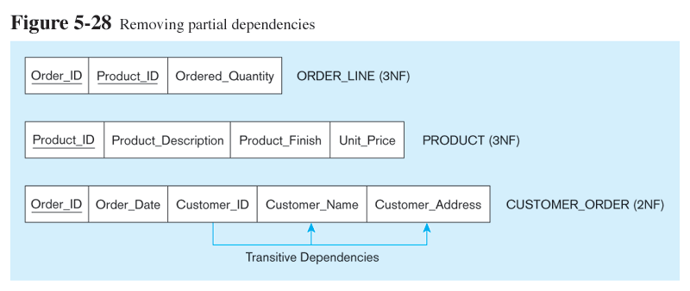
Getting it into Second Normal Form
Partial Dependencies are removed, but there are still transitive dependencies

Slide 38
Violation Example
Example in Rob/Coronel:
  PROJECT ( proj-num(PK), proj-name, emp-num(PK), emp-name, job-class, chg-per-hr, hrs-worked).
Dependencies:
  proj-num, emp-num -> proj-name, emp-name, job-class, chg-per-hr, hrs-worked
  proj-num -> proj-name
  emp-num -> emp-name, job-class, chg-per-hr
Break this up into 3 tables:
PROJECT (proj-num, proj-name)
EMPLOYEE (emp-num, emp-name, job-class, chg-per-hr)
ASSIGNMENT (proj-num(FK), emp-num(FK), hrs-worked)

Slide 39
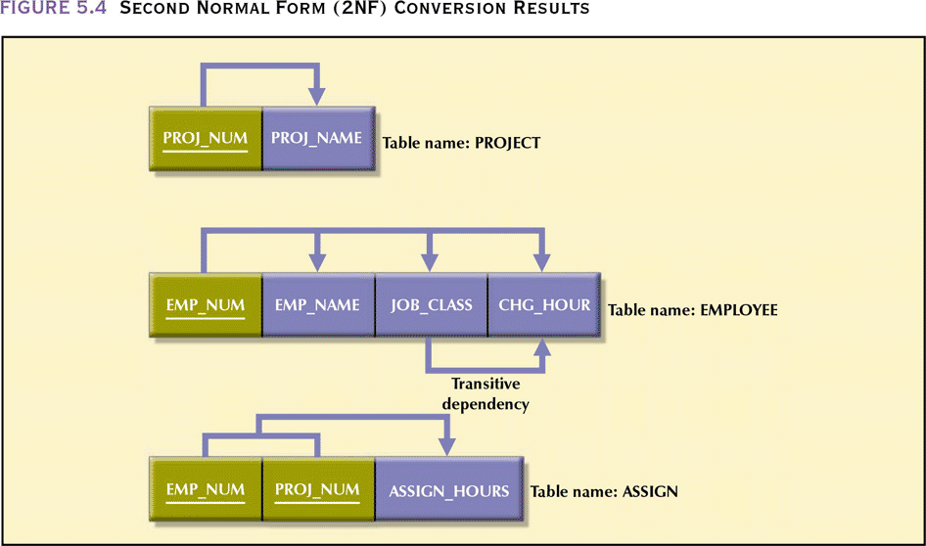

Slide 40
2NF Summarized
In 1NF
Includes no partial dependencies
  No attribute dependent on a portion of primary key
Still possible to exhibit transitive dependency
  Attributes may be functionally dependent on nonkey attributes

Slide 41
Attributes in the Wrong Table
Tax rate depends on the state, not on the employee
EMPLOYEE
employee_id
employee_name
street
city
state
state_tax_rate
Transitive Dependency: state → state_tax_rate

Slide 42
Redundant Information
EMPLOYEE
employee_id
employee_name
employee_birth_date
employee_age
Transitive Dependency: age depends on birth date
employee_age = date() – employee_birth_date

Slide 43
Third Normal Form
2NF PLUS no transitive dependencies (functional dependencies on non-primary-key attributes)
Note: this is called transitive, because the primary key is a determinant for another attribute, which in turn is a determinant for a third
Solution: non-key determinant with transitive dependencies go into a new table; non-key determinant becomes primary key in the new table and stays as foreign key in the old table

Slide 44
Violation Example
2nd normal form still allows transitive dependencies, in which some non-prime attribute(s) determine another non-prime attribute.
EMPLOYEE(employee-id(PK), employee-name, ..., employee-state, state-tax-rate).
  state-tax-rate depends on employee-state, which is not a key attribute.
  state-tax-rate should be stored in the entity STATE(state-id, state-name, state-tax-rate).
  Storing it here may require many occurrences of the same fact, or, if a particular state didn't have any employees, we'd have nowhere to store that state's tax rate.

Slide 45
Violation Example 2
Example in Rob/Coronel:
EMPLOYEE (emp-num, emp-name, job-class, chg-per-hr).
  chg-per-hr depends on job-class.
Solution is another table:
EMPLOYEE (emp-num, emp-name, job-class(FK))
JOB-CLASS (job-class, chg-per-hr)

Slide 46
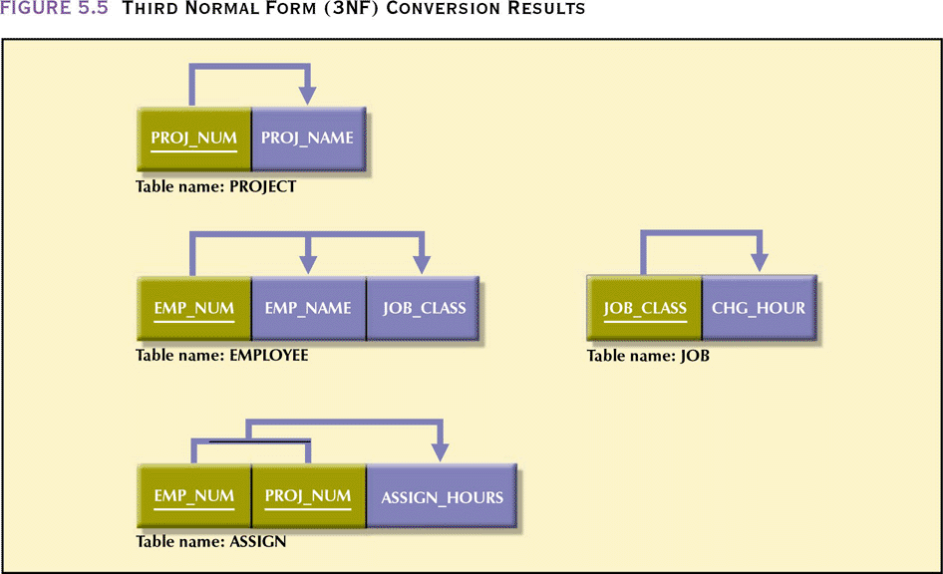

Slide 47
Boyce-Codd Normal Form (BCNF)
Every determinant in the table is a candidate key
  Determinant is attribute whose value determines other values in row
This is equivalent to 3rd normal form plus it prohibits prime attributes depending on non-prime attributes.
3NF table with one candidate key is already in BCNF

Slide 48
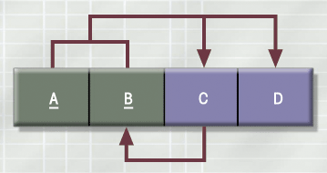
3NF Table Not in BCNF

Slide 49
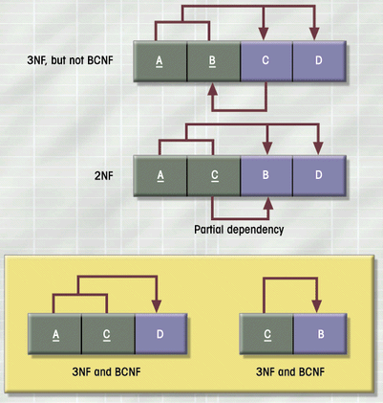
Decomposition of Table
Structure to Meet BCNF

Slide 50
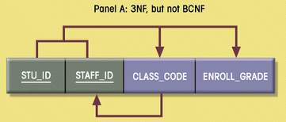
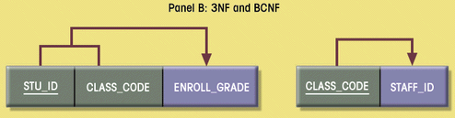
Decomposition into BCNF

Slide 51
Summary
Normalization is a table design technique aimed at minimizing data redundancies
First three normal forms (1NF, 2NF, and 3NF) are most commonly encountered
Normalization is an important part—but only a part—of the design process
Continue the iterative ER process until all entities and their attributes are defined and all equivalent tables are in 3NF
A table in 3NF may contain multivalued dependencies that produce either numerous null values or redundant data
It may be necessary to convert a 3NF table to the fourth normal form (4NF) by
  splitting such a table to remove multivalued dependencies
Tables are sometimes denormalized to yield less I/O which increases processing speed

